Slide 1




Dept. of CSA – BCA
I Year – I Semester
Personal File Organizer
Team Name: THE NEXT LEVEL
J SHOWRYA KIRAN
R.No: 2610520029
POOJA
R.No: 2610520044

Slide 2
Dept. of CSA – BCA
I Year – I Semester
Introduction
Overview of Linux Shell: Linux provides a powerful command-line environment where users can automate repetitive tasks using shell scripts (Bash).
Project Concept: Utilizes Bash script commands to organize files, create directories, and manage sample files.
Environment: Ubuntu Linux / WSL
Technology: Bash Shell Scripting

Slide 3
Dept. of CSA – BCA
I Year – I Semester
Problem Statement
Alex just started a new job as a junior digital archivist at a local media firm. On their first day, Alex notices that the digital workspace is a complete mess—important project documents and image assets are mixed together without any structure. To make matters worse, team members constantly struggle to locate which files were created first during a project audit.
Alex's team lead gives them a task: Write an automated, beginner-friendly script to set up an organized folder system for new projects.

Slide 4
Dept. of CSA – BCA
I Year – I Semester
Objectives & Scope of the project
Objectives
Scope of the project
Practice basic Linux command-line and Bash scripting skills.
Create sample files using touch within specific folders.
Format text outputs cleanly using echo and blank lines.
Limited to running organize.sh via the terminal and nano editor.
Focuses on foundational commands (touch, echo) rather than sorting or moving existing files.

Slide 5
Dept. of CSA – BCA
I Year – I Semester
Existing vs. Proposed System
Existing System
Proposed System
Files managed manually through the terminal one by one.
Time-consuming and prone to typing mistakes.
Lacks a consistent script to present file outputs in an automated order.
Uses an automated Bash script (organize.sh) written in nano.
Instantly displays headings, creates files (Documents/notes.txt, Images/photo.jpg), and organizes output sections cleanly.

Slide 6
Dept. of CSA – BCA
I Year – I Semester
System Requirements
Hardware Requirements
Software Requirements
Computer or laptop
Minimum 4 GB RAM recommended
Keyboard and display
Ubuntu Linux or Windows Subsystem for Linux (WSL)
Bash shell
Terminal application and text editor (nano or vim)

Slide 7
Dept. of CSA – BCA
I Year – I Semester
System Design & Process Flow
Design Steps
Process Flow
Open terminal and edit organize.sh using nano.
Run script using bash organize.sh.
Script executes echo and touch commands sequentially.
Start → Open Terminal → Edit/Create Script → Save & Exit → Execute Script → Output Displayed → End.

Slide 8
Dept. of CSA – BCA
I Year – I Semester
Algorithm
Start the terminal.
Create or open organize.sh using nano.
Display project heading: PERSONAL FILE ORGANIZER.
Create sample files (Documents/notes.txt, Images/photo.jpg) using touch.
Display File1.txt, File2.txt, and File3.txt in order.
Print a blank line, display WORK FILES, followed by Workfile 1, Workfile 2, and Workfile 3.
Save script, exit editor, and run via bash organize.sh.

Slide 9
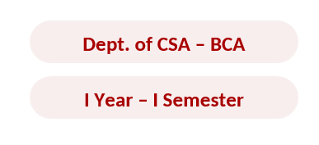

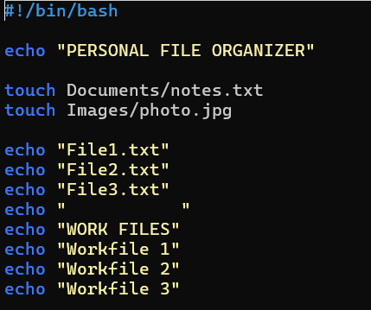
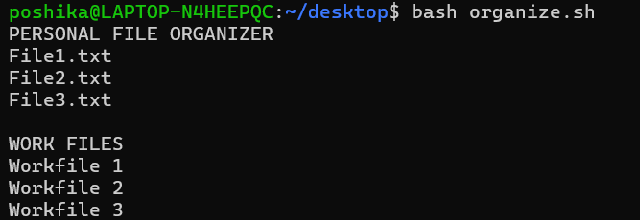

Execution
Input
Process
Output

Slide 10

12. Team Members and Responsibilities
TEAM MEMBER | RESPONSIBILITIES | DELIVERABLES
POSHIKA BOMMIDENI | Problem analysis, Bash logic, path validation, file operations | Source code and algorithm
NIKITHA SRIRANGAM | sample outputs, documentation, presentation | Project report

Slide 11
13. Advantages
● Easy for beginners to understand and use.
● Automates the display of headings and file names.
● Creates the specified empty files using touch.
● Runs from the Linux terminal with a simple command.

Slide 12
14. Limitations
● File names are fixed in the script and cannot be entered by the user.
● It only creates the files; it does not organize existing files.
● The Documents and Images folders must already exist, or touch may fail to create the files.
● Running the script repeatedly displays the same names and leaves existing files unchanged.

Slide 13
15. Future Enhancements
● File names are fixed in the script and cannot be entered by the user.
● It only creates the files; it does not organize existing files.
● The Documents and Images folders must already exist, or touch may fail to create the files.
● Running the script repeatedly displays the same names and leaves existing files unchanged.

Slide 14
16. Learning Outcomes
● File names are fixed in the script and cannot be entered by the user.
● It only creates the files; it does not organize existing files.
● The Documents and Images folders must already exist, or touch may fail to create the files.
● Running the script repeatedly displays the same names and leaves existing files unchanged.

Slide 15
17. Conclusion
The Personal File Organizer project demonstrates basic Bash scripting. It displays headings and file names and creates sample files in specified folders. While it does not organize existing files, it provides a foundation for learning how to automate file-related tasks in Linux.

Slide 16
18. References
● The Linux man-pages: bash, mkdir and related commands.
● GNU Bash Reference Manual.
● Ubuntu Linux documentation.
● Course notes and laboratory material provided by the faculty.

Slide 17



